Slide 1
Database Systems: Achievements and Opportunities
Avi Silberschatz, Michael Stonebraker, Jeff Ullman
October 1991
By Uzma Ali
Notes:
This paper was presented in 1991 as part of the ACM Communications. Communications of the ACM is the monthly Journal of the Association for Computing Machinery (ACM).

Slide 2
Agenda
Motivation
Database Research Overview
Research Contributions
What Does Future Hold?
Suggested Research Directions
Conclusion
Q&A
Notes:
30sec

Slide 3
Motivation

Slide 4
Motivation
Envision Future
Analyze Past
Suggest Current Opportunities
Inspire Database Research
And contradict the general assumption in 1990’s that the database technology is mature
Notes:
1 min: This paper was released in year 1991. In the beginning of 1990s, the research funding for databases was being moved to other research projects, as it was considered that the database technology has become mature. This paper shows the evolution of databases & the technological advancements due to database research. The paper suggests database research that could support the industry advances.

Slide 5
Database Research Overview

Slide 6
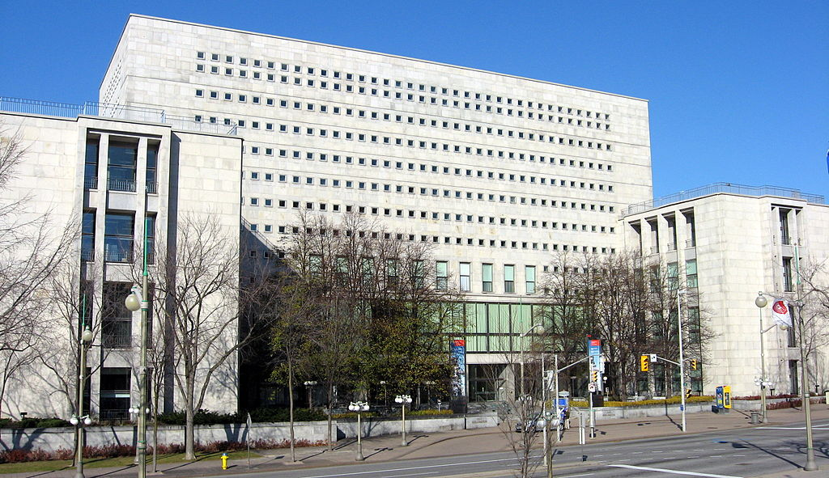

Growing Data
Library and Archives Canada
Largest Library in Canada
Can Lieutenant Commander Data from Star Trek find relevant information from this library?
20 million books and publications
3 million architectural drawings, maps and plans
24 million photographs
350,000 hours of film
More than a billion megabytes of digital content
His total linear computational speed was 60 trillion operations per second. So maybe he could.
AND GROWING…..
Notes:
1 min – 2.5

Slide 7

What is a Database?
Database: The Information you lose, when your memory crashes. Dave Barry
A database is an organized collection of data
Notes:
30 secs - 3 Lieutenant Commander Data also has a storage capacity of 100 PB. Even if his memory was lost, the information would be lost, if its not stored in databases. Databases is the basis of advances in all type of industries.

Slide 8
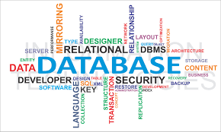
Database Management Systems
A database management system (DBMS) is system software for creating and managing databases.
The DBMS provides users and programmers with a systematic way to create, retrieve, update and manage data..
Notes:
1 mins - 4 Lieutenant Commander Data also has a storage capacity of 100 PB. Even if his memory was lost, the information would be lost, if its not stored in databases. Databases is the basis of advances in all type of industries.

Slide 9
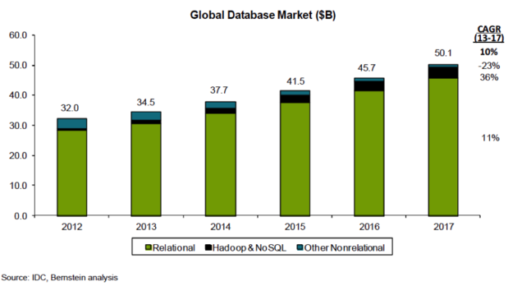
Database Industry Revenue Trend
The compound annual growth
rate (CAGR) from Year 2013 to
Year 2017 is 10%
http://www.infoworld.com/article/2916057/open-source-software/open-source-threatens-to-eat-the-database-market.html
Notes:
1 min. 5 . Relational vs Non relational databases will be discussed in the later sections of the presentation. At the time in year 1991, according to the paper, the information services industry was estimated at $10 billion/year for US alone.

Slide 10
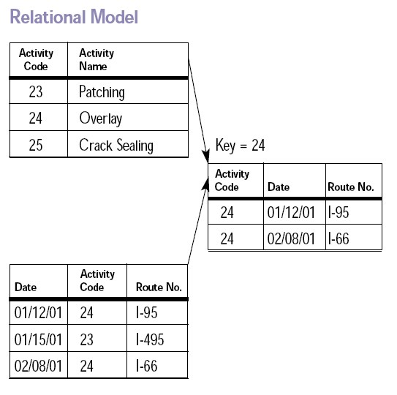
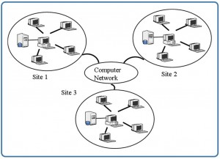
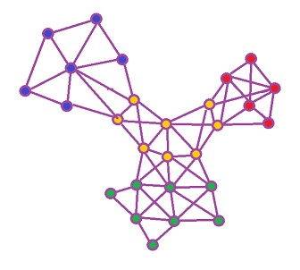
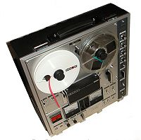
Database Research vs Commercialization
Market Offering
Research
1980s Relational Databases
1980s Object Databases
1970s Navigational Databases
1970s Relational Databases
1960s File Systems
1960s Navigational Databases
Technological Advancements in the industry are followed by years of research
Notes:
1 min 30 secs: 6.5 The database research community exists since the late 1960s. The years of research is followed by the commercialization of new database technologies. File Systems were followed by Navigational databases. The driver behind the change of research focus for any era is economic impact and the advancement in computer hardware. The navigational databases were costly to use because of the low level interface between application program and DBMS and required continued program maintenance.

Slide 11
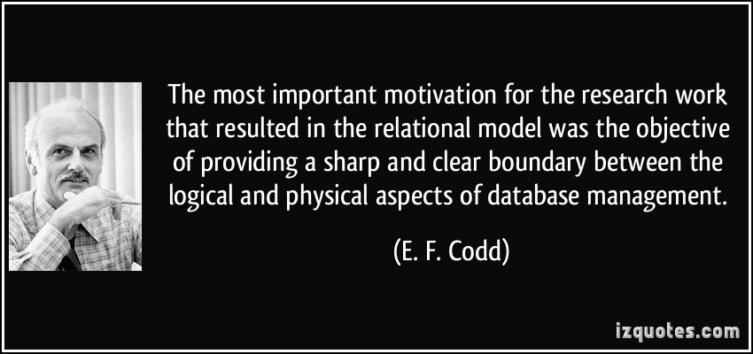
Example: Database Research Impact
Notes:
1min secs- 7.5 Relational model’s success can be attributed to the considerable research done. An important concept on logical and physical aspects of database management were identified. Setting up the direction of the research is a key factor to achieve success.

Slide 12
Research Contributions

Slide 13
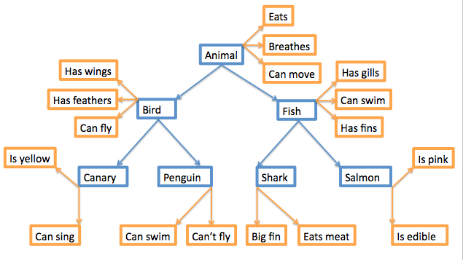
Evolution of the Relational Model
Hierarchical Model
Network Model
Relational Model
Notes:
30 secs – 2 types of navigational models

Slide 14
Hierarchical Model
IBM Information Management System (IMS) – still in use
All data records are assembled into a collection of trees
Programmer defined physical storage format
Complex application programs required to navigate the database for simple queries
Department
Professors
Courses
Students
Notes:
30 secs. 1 It was also used in 1960s for the Apollo Space Mission.

Slide 15
Network Based Model
Integrated Data Store (IDS) was the basis of CODASYL standards
Allows generalized graph structure to represent objects and relationships
It was not easy to use or implement applications with IDS, because it was designed to maximize performance using the hardware available at that time
Department
Professors
Courses
Students
Notes:
1 mins. 2While the hierarchical database model structures data as a tree of records, with each record having one parent record and many children, the network model allows each record to have multiple parent and child records, forming a generalized graph structure

Slide 16
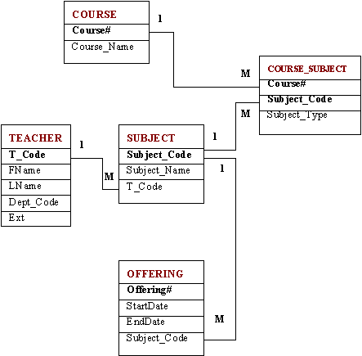
Relational Model
All Data is stored into tuples and then grouped into tables
The tables are stored independently
Users would use a high level, non-procedural, declarative language to provide the required information
The DBMS would take care of storing the data and retrieval procedures for answering queries by using query optimizer
Notes:
1 min.3

Slide 17
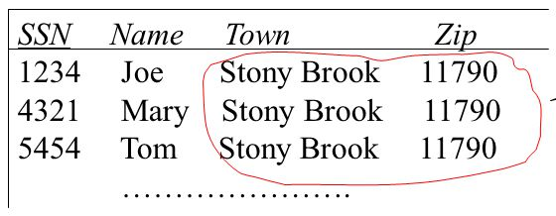
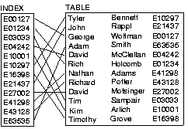
Research on Relational Model
Invent of high level relational query language eg SQL.
Development of algorithms to optimize queries. That is translate queries into plans that are as efficient as programs written for Navigational DBMS.
Formulated theory of normalization to eliminate redundancy.
Created indexing techniques for fast access to data records
Developed algorithms to move data between disk and main memory pool understanding the access patterns
SELECT *
FROM Courses c
INNER JOIN Departments d
On c.deptid=d.deptid
Notes:
2m 30 secs 5.5

Slide 18
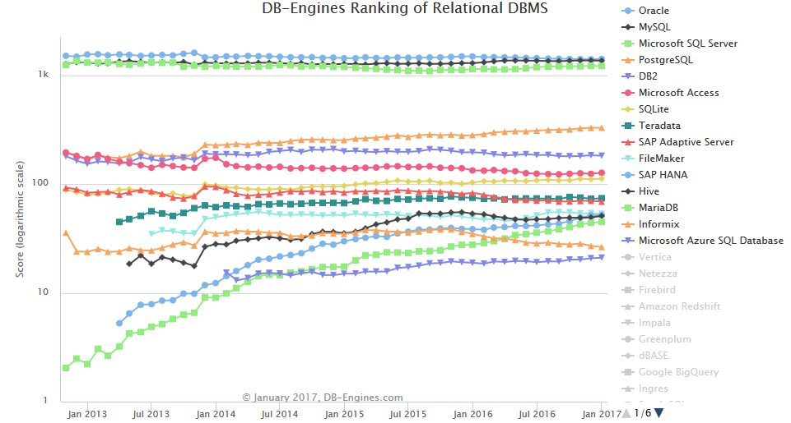
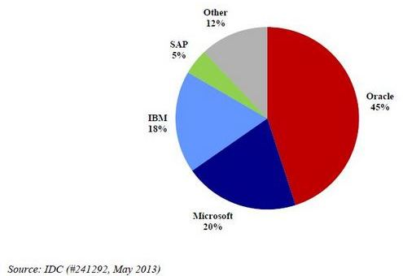
Results of Research on Relational Model
Numerous commercial relational products came into market in 1980s.
1990 onwards, commercial relational databases are available for all hardware platforms ranging from personal computers to mainframes.
http://db-engines.com
Notes:
1 min – 6.5 min total

Slide 19
Transaction Management
A transaction is a series of operations on a DBMS that follow ACID properties.
Write Ahead Logging
Atomicity
Consistency
Isolation
Durability
Two Phase Locking
Concurrency Control
Shadow File Techniques
Recovery Techniques
Notes:
2.5 mins – 9 mins
Transaction management is the basis of e-commerce and online banking sites. Lets take an example

Slide 20

Transaction Management
Atomicity
Consistency
Isolation
Durability
All or nothing
This property states that the transaction is executed as a single unit of work. That is, either all actions within the transaction are carried out or none are.

Slide 21
Transaction Management
Atomicity
Consistency
Isolation
Durability
No constraints are violated
This property states that each transaction run by itself must preserve the consistency of the database.

Slide 22
Transaction Management
Atomicity
Consistency
Isolation
Durability
Users (sessions) don’t affect each other
This property states that due to performance reasons, multiple transactions are interleaved.

Slide 23
Transaction Management
Atomicity
Consistency
Isolation
Durability
Once data is committed, it is permanent
This property states that transactions survive system crashes and failures.

Slide 24
ACID Techniques
Concurrency Control – providing Isolation & Consistency assurance
Two phase locking
Requires transactions to obtain all locks before releasing all.
Prevent serializability violations by using access timestamps
Recovery – providing Durability
Write-ahead Logging
Effects of transaction are logged in a sequential file that enables database restoration
Shadow file techniques
Keeping additional copy of the database file(s).
Notes:
1 min 30 – 10.5 - Serializability is the effect on the database of any number of transactions executing in parallel must be the same as if they were executed one after another, in some order.
The log is kept on a disk or tape, where it can survive

Slide 25

Distributed Databases
The data can come closer to the users responsible for maintaining it
The decentralized system is less likely to crash with all the system wide outage
Less likely to lose replicated data if one site goes down
Notes:
1 min – 11.5 -Providing location transparency required the DBMS research community to investigate new algorithms for distributed
query optimization, concurrency control, crash recovery, and support of multiple copies of data objects for higher performance
and availability.

Slide 26
What Does Future Hold? (late 1990s onwards)

Slide 27
Future Looks Bright
As 1990s unfold, computing and hardware will become cheaper
As a result, relational databases will become cheaper too
The databases management systems will be much more commonly used in various industries.
But as computing resources become cheaper, the industry application problems will also expand at the same rate.

Slide 28



Future Challenges in the Industry
Images
Storage
nasa.gov
Handing Objects
Pattern Mining
Satellite Images storage and allowing relevant search
Working with Complex DNA Sequence objects
Multimedia
Data
Market Basket Analysis
Notes:
2 min 30 secs - Identifying buyer patterns, provide recommendations for buyers. Multimedia data such as images, videos and audio files. NASA has been collecting the satellite images since mid 1900s, allowing relevant search would be a future challenge. 10,000 optical disks for few years worth satellite images. The gene sequence is several billions long. Dept stores.

Slide 29
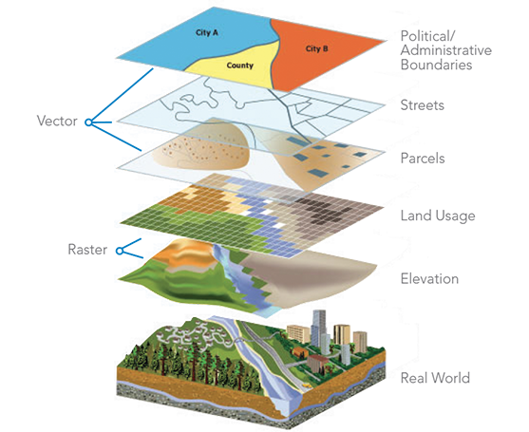
New Data Modeling Concepts – Spatial Data
Possible Multi-Dimensional Complex Queries
Can we find 10 closest neighbours to a particular location in the city?
learn.arcgis.com
Notes:
1 min – 3.5

Slide 30
Suggested Research Directions

Slide 31
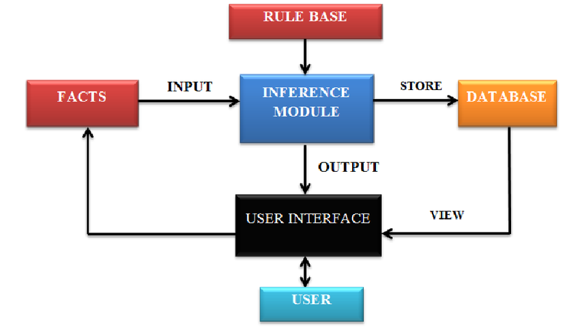
Rule Based System – Artificial Intelligence
Classifying a disease based on patients symptoms and lab results
Provided facts are checked with the rule base by an inference module to come up with conclusions.
In the future, the whole rule based system could be extensions of a DBMS.
As the data structures increase over time, the traditional AI tools that assume all relevant data is in main memory wont work
Reference: A rule-based expert system for automated ECG diagnosis, Sept 2013
Notes:
1 min 30sec - In the 1980s the rule based or expert systems will pre-dominantly used for medical diagnosis. Inference module is an automated reasoning system. If/then/else – declarative rules

Slide 32
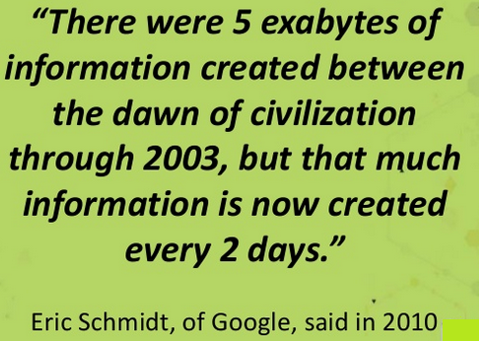
Scaling Up
All the DBMS Algorithms (concurrency control, transaction management) also need to scale up as required by the industry in the future
1991
Terabytes
2017
Zettabytes
Notes:
1 min 30 secs – 5 . Terabyte is 10 power 12. Zetta byte is 10 power 21. Exabyte is 10 power 18

Slide 33
Tertiary Storage
Ultra large databases will require archive storage
Since higher latency would work for such data, tertiary storage would be the go-to options
More research needs to continue as the expansion of the world data is continuing.
Storage Device | Cost/MB | Latency Data Rate
Magnetic Disks | 20c | 25 ms 5-8 MBps
Tapes (low end) | 0.5c | 3 rain 1.5 MBps
Tapes (high end) | 0.7c | 3 rain 10 MBps
Optical Disks | 10c | 1.25 MBps
Reference
Tertiary Storage Systems: Solving Multimedia DBMS Storage Problems
Greg Magsamen – September 27, 2007
Notes:
1 mins : Amazon Glacier offers 1GB storage for a cent

Slide 34

Parallelism
Can adding more CPU processors and adding more disks to a database server infrastructure linearly improve the database query speed?
To obtain linear speedup, research must be done to optimize the architecture to reduce overheads.
This will be an evolving area considering optimizations and the reducing costs of hardware
CPU
CPU
CPU
Database Server
Notes:
1 min 30 – 6.5Invent of CPU cores happened in the 1990s. Distributed computing such as Hadoop frameworks utilize parallelism concepts.

Slide 35

Heterogeneous, Distributed Databases
The mediator fuses semantically inconsistent data
User gets the feeling that interaction is only with a single database with a global schema
Flights
Hotels
Car Rentals
Mediator
Source:
http://people.scs.carleton.ca/~bertossi/talks/dublin08.pdf
Notes:
1min 30 secs – 8 The Mediator does not warehouse the data--only the information about the data.

Slide 36
Heterogeneous, Distributed Databases
Interconnection of Information will be the key for collaborative applications Eg. The Human Genome Project, wikipedia
Intercompany applications will also pose interoperability issues
Security requirements for heterogeneous distributed databases could also be complex
Notes:
3 mins – 11 . Wikipedia is a Web-based, multi-language, free-content encyclopedia written collaboratively by volunteers
The Human Genome Project remains the world's largest collaborative biological project. It was formally launched in 1990. determining the sequence that make up human DNA, and of identifying and mapping all of the genes of the human genome from both a physical and a functional standpoint. Many people are constantly improving Wikipedia, making thousands of changes per hour. Since its creation in 2001, Wikipedia has grown rapidly into one of the largest reference websites,

Slide 37
Conclusion

Slide 38
Conclusion
The inspirations of the database research suggested by this paper are evident such as the advent of the Big Data technologies.
The database research still needs to continue even today for the advancement of various industries and evolving new technologies.
Reference
Andy Pavlo, History of Databases, CMU Database Group. Retrieved From https://www.youtube.com/watch?v=MyQzjba1beA
Notes:
1 min – 12 . This paper makes a great effort in explaining the database research contributions prior to 1990s. The heterogeneous data modeling issues exist since the beginning of databases. Youtube Netflix for multimedia database. , Microsoft picked on XML as an alternative approach to the interoperability puzzle, and became XML’s greatest advocate

Slide 39
Q&A

